Slide 1
Dependency Analysis for Kactus2

Slide 2
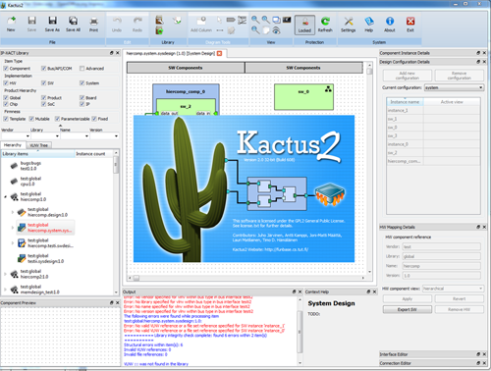
Background
Client: Timo Hämäläinen
Kactus2
  Developed at TUT
  Open-source toolset to design embedded products, especially FPGA-based MP-SoCs
  Based on IP-XACT XML metadata and design methodology

Slide 3
Background 2
Kactus2 goals
  Easier IP reusability
  Practical HW/SW abstraction for easier application SW development
  The most user-friendly EDA tool
Handling file dependencies is essential for good usability

Slide 4
Problem
Both hardware and software projects include high amounts of files dependant on other files.
  Class instancing in C++
  Component instances in VHDL
  Not only strict code dependencies – for example a hardware component might be dependant on a block specification document.
As project size increases, it becomes more and more difficult to keep track of these file dependencies.
What files might a change in this file have an effect on?

Slide 5
Dependency Analysis Tool
Overview
The tool automates the file dependency tracking by scanning supported files and keeps track of file changes.
The user should be able to see with one quick glance if a change has been made in a file another file depends on.
As not all dependencies can be found automatically, user should also be able to specify dependencies manually.
Initially automatic scan support is only planned for C, C++ and VHDL, but the system should be modular so that it is easy to implement additional file types.

Slide 6
Dependency Analysis Tool: UI

Slide 7
Dependency Analysis Tool
Features
Choosing and Managing Source Directories
Running Dependency Analysis
Manual Connections
Editing Existing Connections
Filtering Connections
External Dependencies
Settings

Slide 8
Project Group
3 group members
    Joni-Matti: project manager, SW architect and developer
      6th year student at TUT
      Original member of the Kactus2 team
    Mikko: Test lead and development tasks
      5th year student at TUT
      Studies in both hardware and software
      A good amount of experience in C++
    Tommi: UI specialist and SW developer
      5th year student at TUT
      Studies in both hardware and software

Slide 9
Schedule
Estimated total time: 619 hours
Schedule for 2012
  Planning and writing specification documents
Schedule for 2013
  SW development and testing

Slide 10
Schedule 2012

Slide 11
Schedule 2013

Slide 12
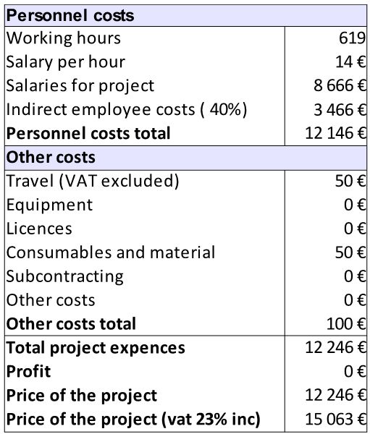
Budget
As the project requires no special equipment, salary costs are the only major cost in the project.
Any tools used are also available for free or with free licensing for students.
Some additional costs come from travel (meetings at the university) and materials such as paper.
Funding for the project comes from Tampere University of Technology.

Slide 13
Project Management
Weekly meetings
    Review of what has been done on the past week
    Decisions what will be done on the next week
    Open questions are addressed
Client meetings once in every two weeks
    Especially important when making functional specification
Redmine
    Free project management software
    Centralized place for tasks, issues and time management

Slide 14
Conclusion
TODO Joni-Matti

